Slide 1
Support Vector Machines

Slide 2
Learning Goals
In this section, we will cover:
- Support Vector Machines (SVM) approach to Classification
- Comparing SVM and Logistic Regression
- The SVM cost function
- Regularization in SVM models

Slide 3
Support Vector Machines (SVM)
Support Vector Machines are supervised learning models with associated learning algorithms that analyze data for classification and regression analysis.
Developed at AT&T Bell Laboratories by Vladimir Vapnik with colleagues (Boser et al., 1992, Guyon et al., 1993, Cortes and Vapnik, 1995, Vapnik et al., 1997) SVMs are one of the most robust prediction methods, being based on statistical learning frameworks or VC theory proposed by Vapnik (1982, 1995) and Chervonenkis (1974).
Given a set of training examples, each marked as belonging to one of two categories, an SVM training algorithm builds a model that assigns new examples to one category or the other, making it a non-probabilistic binary linear classifier.

Slide 4
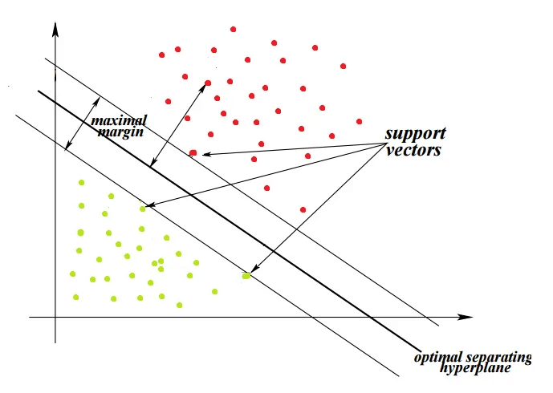
Support Vector Machines (SVM)
Support Vectors: the data points that lie farthest to the decision surface (or hyperplane). They are the data points which are most difficult to classify. They have a direct impact on the optimum location of the decision surface.

Slide 5
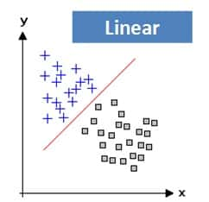
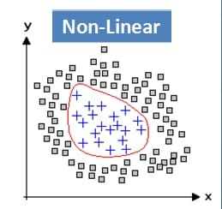
Support Vector Machines (SVM)
Linearity and Non-Linearity: On a Plane, a linear function is a function where the graph is a straight line. The line can go in any direction, but it’s always a straight line. However, a non-linear function has a shape that is not a straight line.

Slide 6
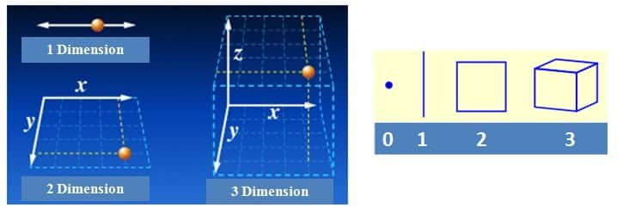
Support Vector Machines (SVM)
Dimensions: In simple terms, a dimension of something is a particular aspect of it. Examples: width, depth and height are dimensions. A line on a plane is one dimension, considering the edges a square has two dimensions and a cube has three dimensions.

Slide 7
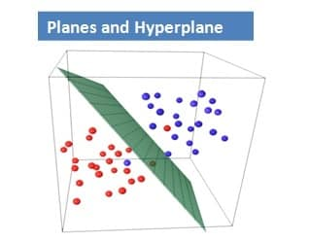
Support Vector Machines (SVM)
Hyperplane: a decision plane or space which is divided between a set of objects having different classes. In one dimension, a hyperplane is called a point. In two dimensions, it is a line. In three dimensions, it is a plane and in more dimensions we call it a hyperplane.

Slide 8
Support Vector Machines (SVM)
Margin: It may be defined as the gap between two lines on the closet data points of different classes. It can be calculated as the perpendicular distance from the line to the support vectors. Large margin is considered as a good margin and small margin is considered as a bad margin.

Slide 9
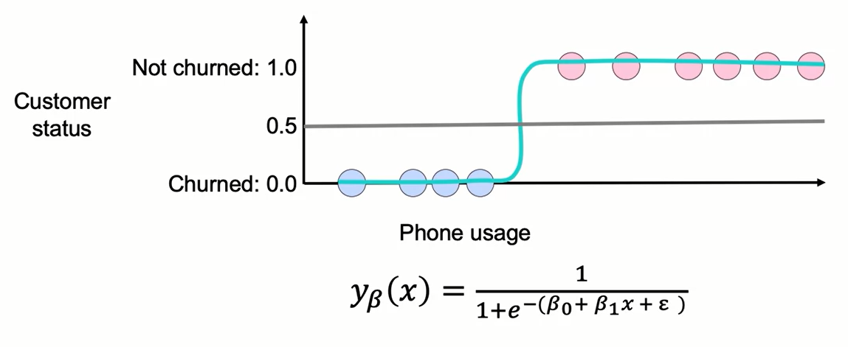
Recall Logistic Regression

Slide 10
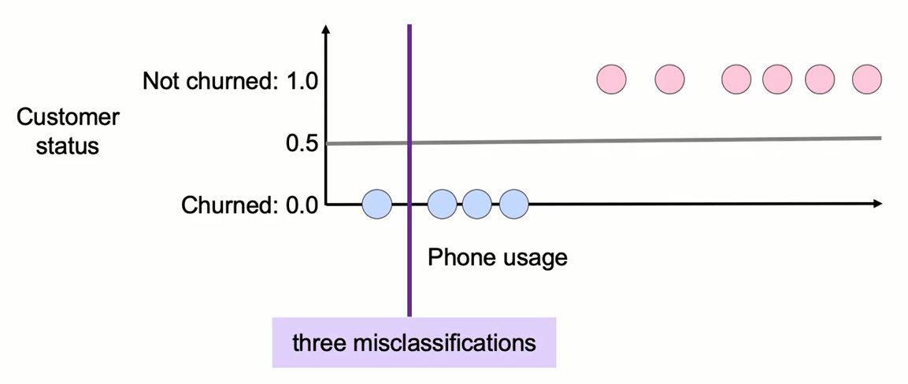
Support Vector Machines (SVM)

Slide 11
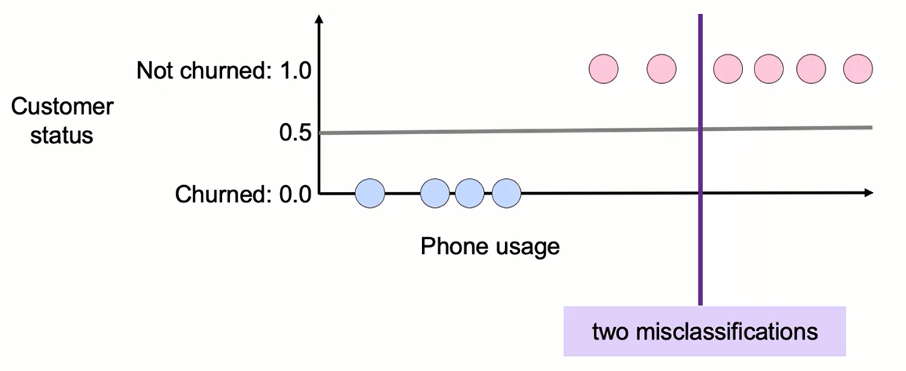
Support Vector Machines (SVM)

Slide 12
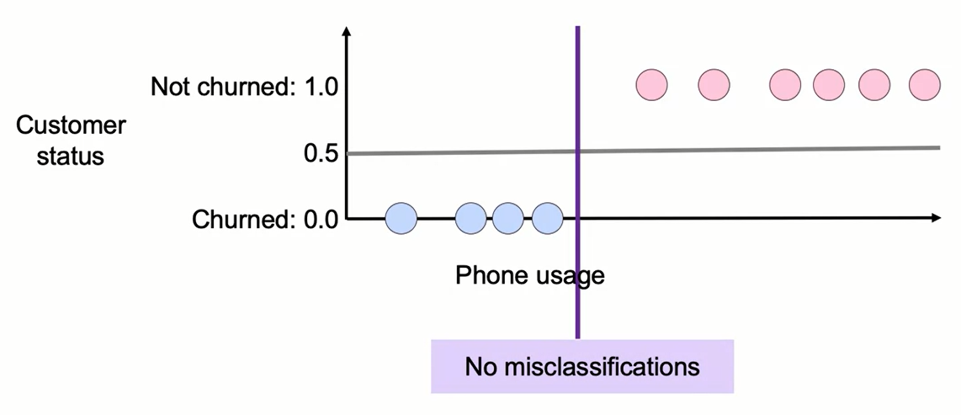
Support Vector Machines (SVM)

Slide 13
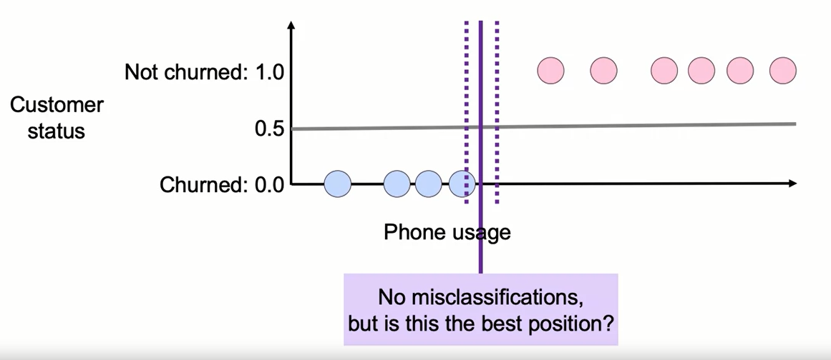
Support Vector Machines (SVM)

Slide 14
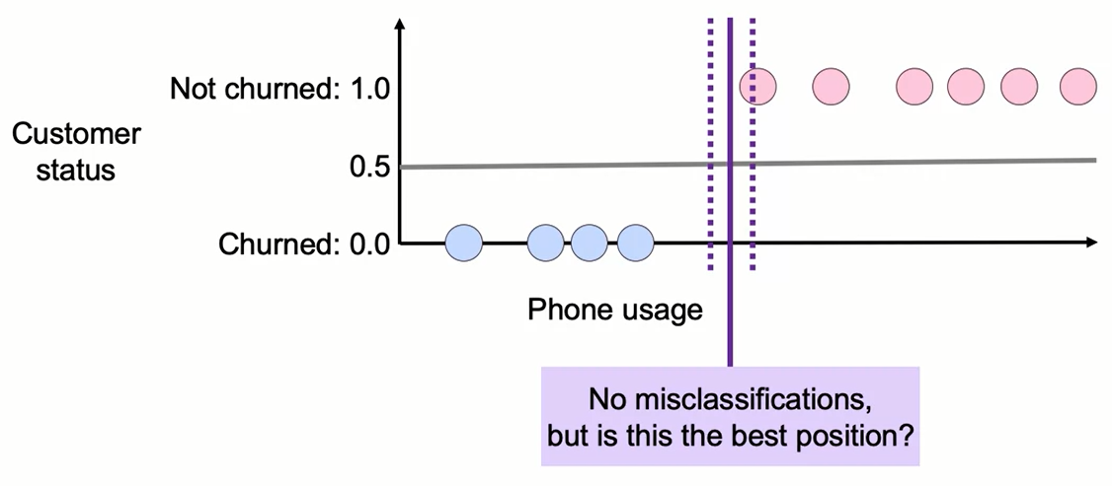
Support Vector Machines (SVM)

Slide 15
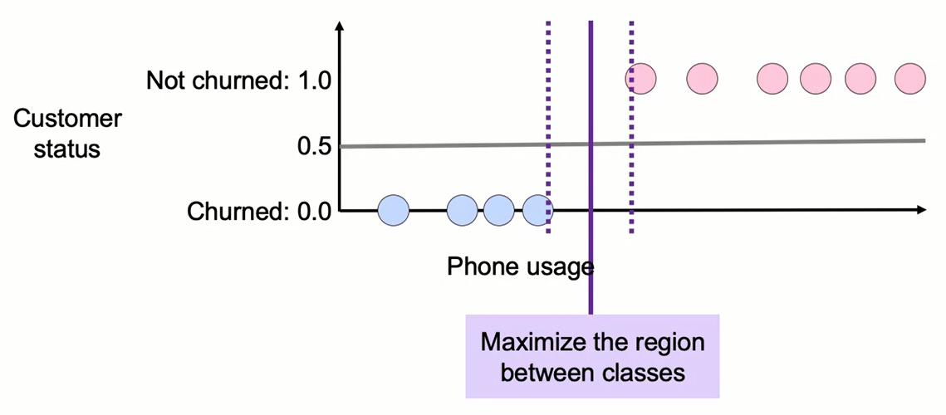
Support Vector Machines (SVM)

Slide 16
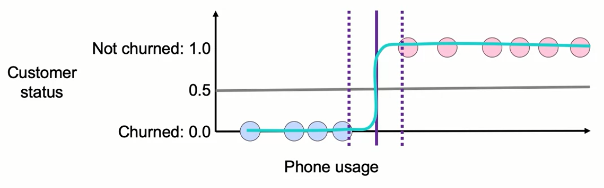
Logistic Regression vs. SVM

Slide 17
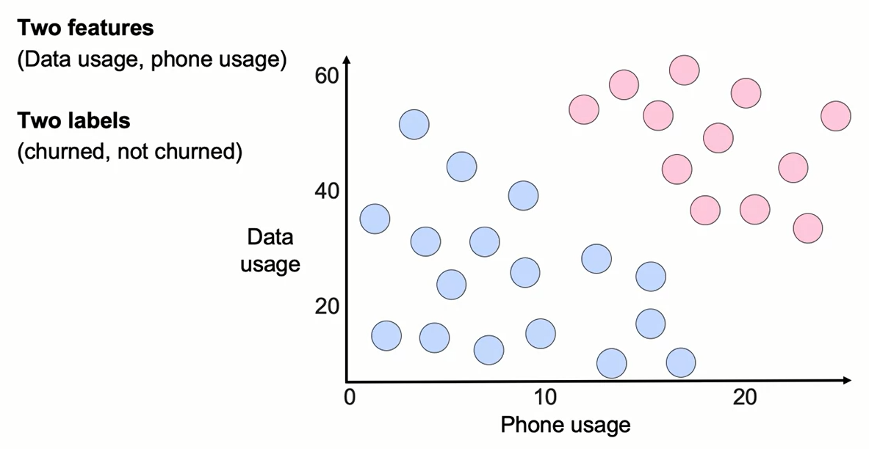
Classification with SVMs

Slide 18
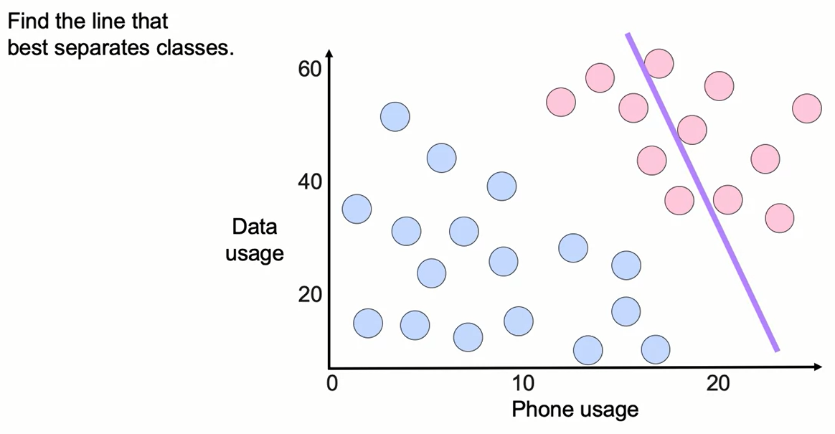
Classification with SVMs

Slide 19
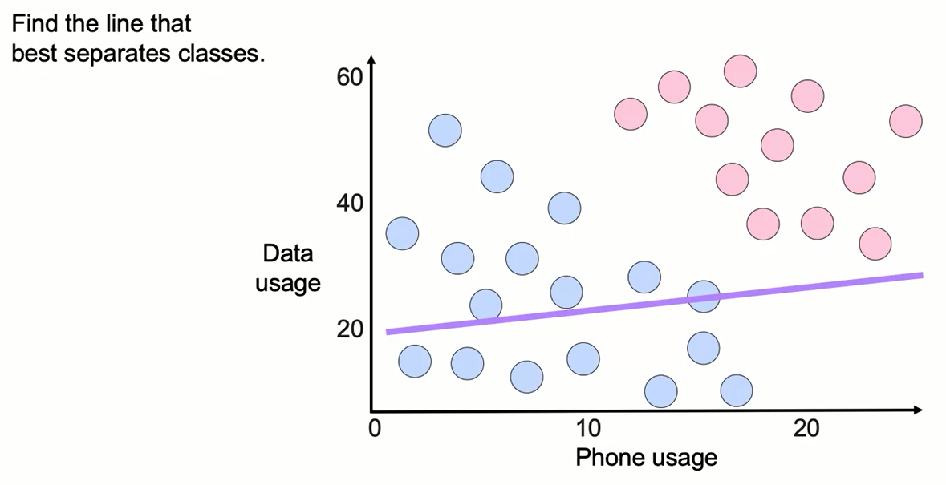
Classification with SVMs

Slide 20
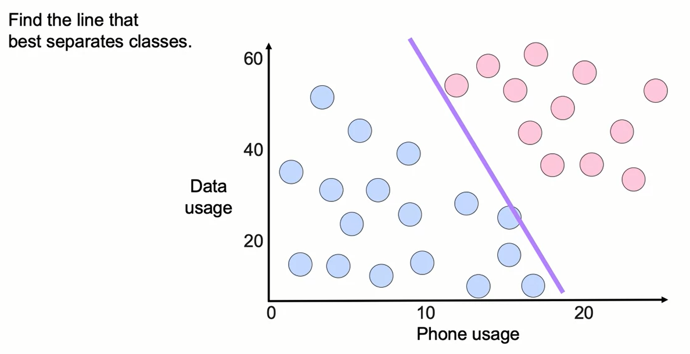
Classification with SVMs

Slide 21
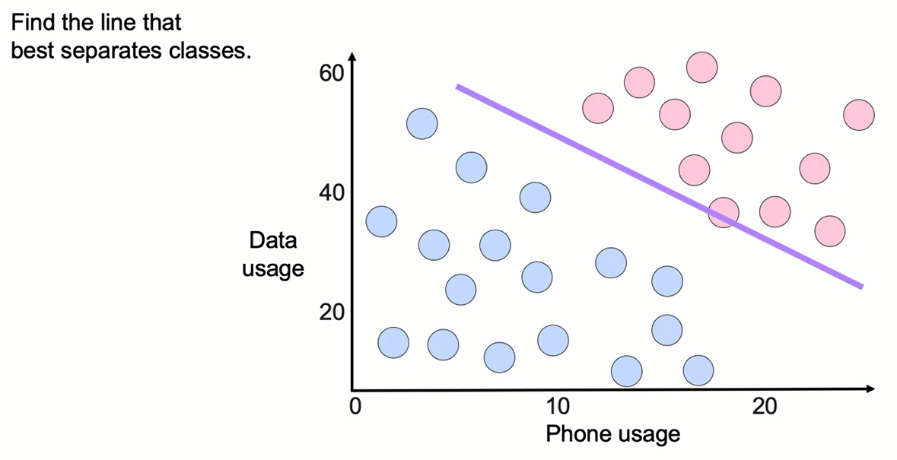
Classification with SVMs

Slide 22
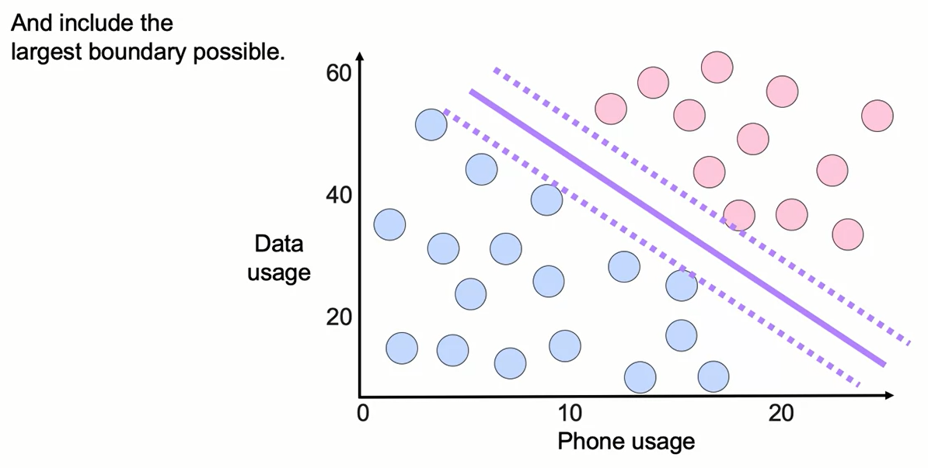
Classification with SVMs

Slide 23
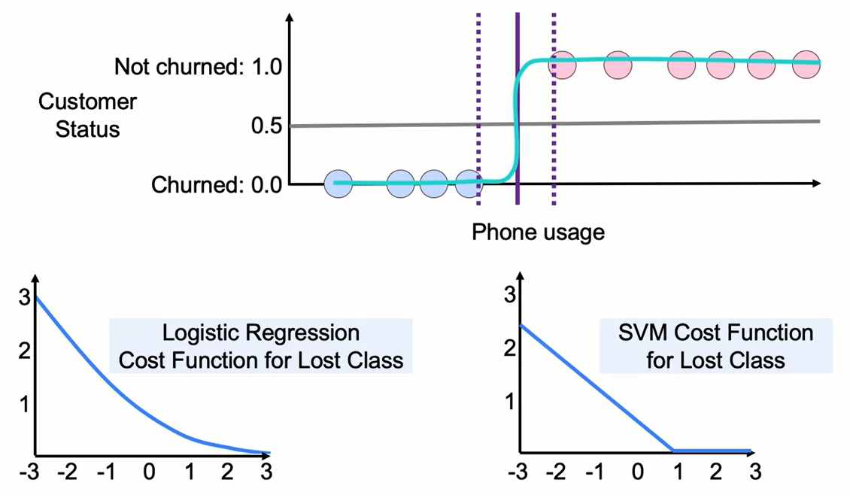
Logistic Regression vs. SVM

Slide 24
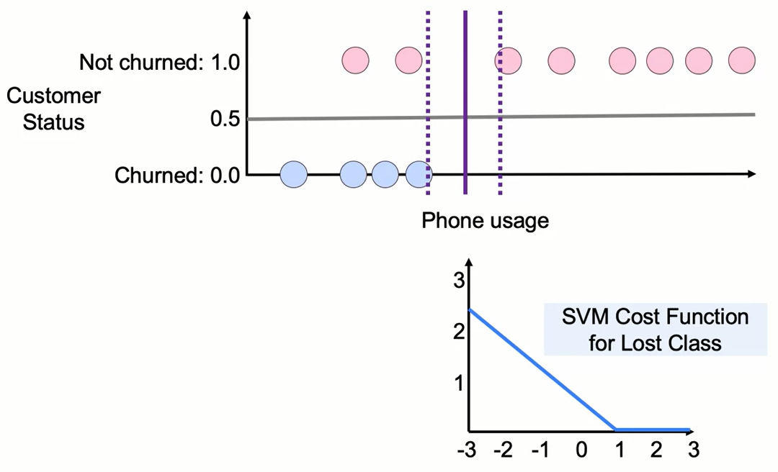
The SVM Cost Function

Slide 25

The SVM Cost Function

Slide 26
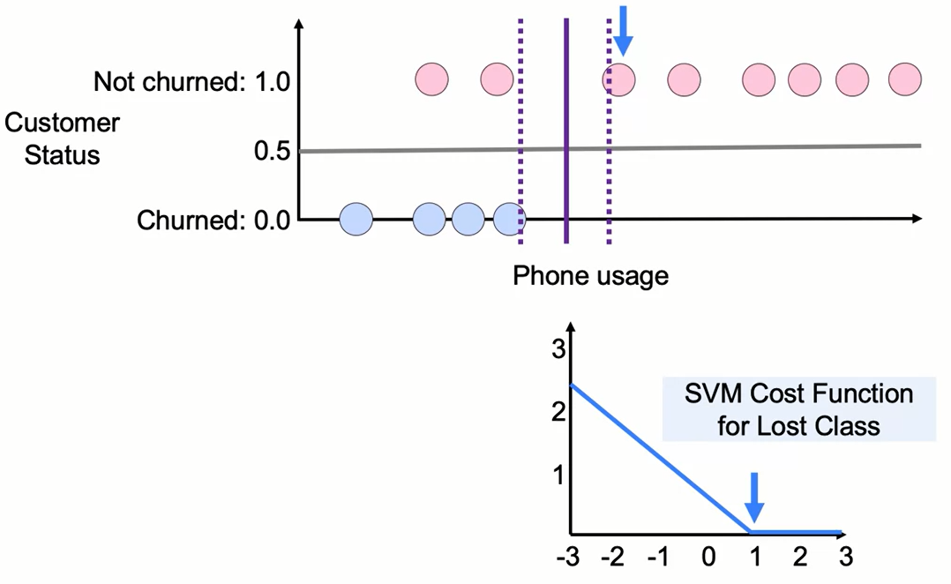
The SVM Cost Function

Slide 27
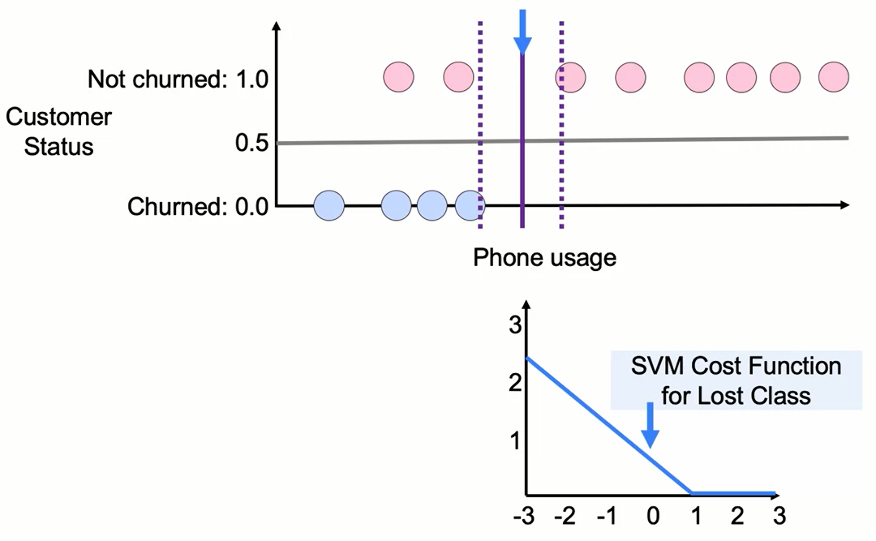
The SVM Cost Function

Slide 28
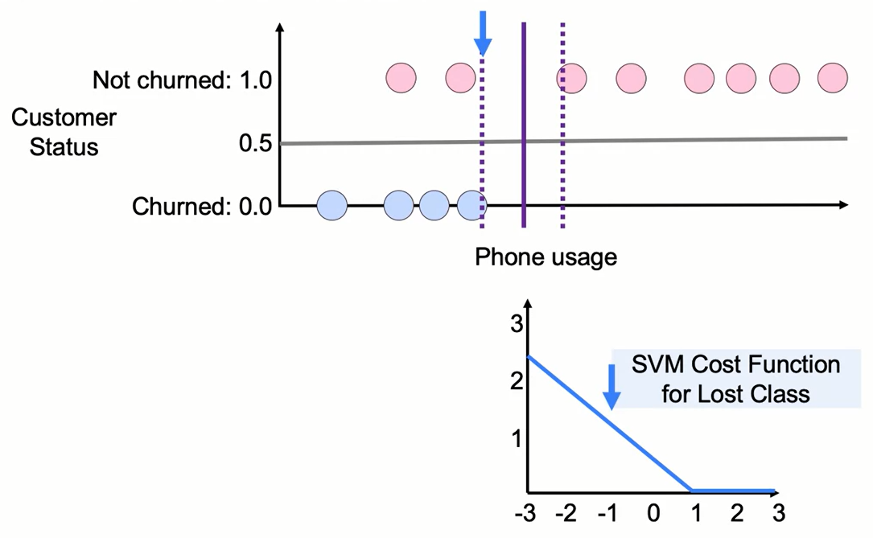
The SVM Cost Function

Slide 29

The SVM Cost Function

Slide 30
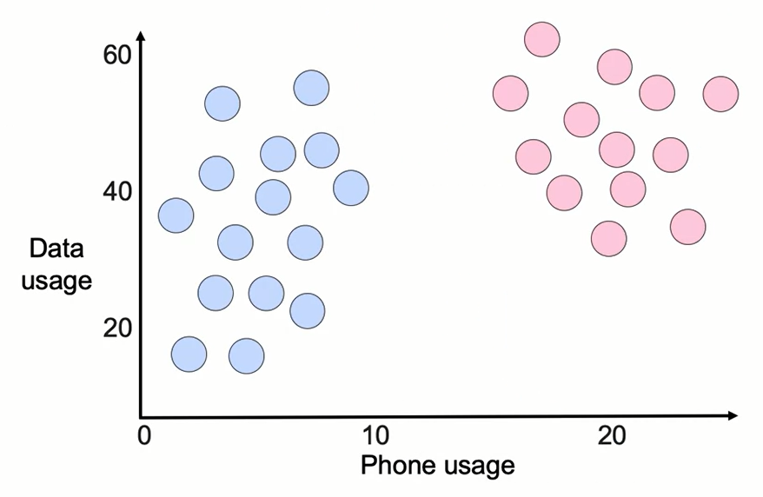
Outlier Sensitivity in SVMs

Slide 31
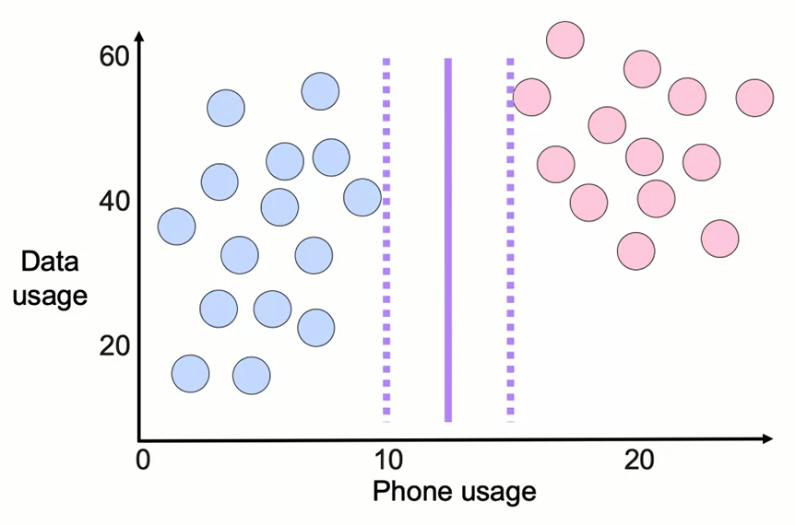
Outlier Sensitivity in SVMs

Slide 32
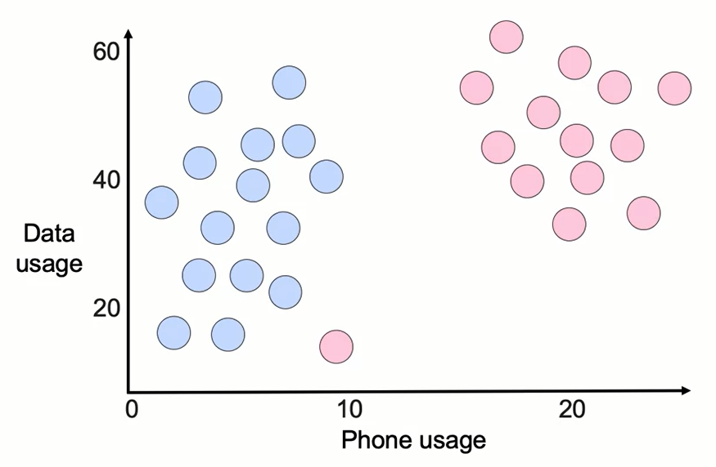
Outlier Sensitivity in SVMs

Slide 33
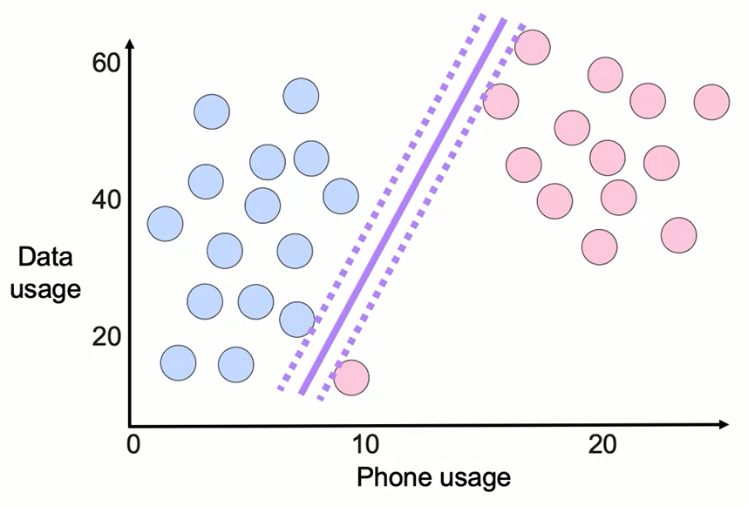
Outlier Sensitivity in SVMs

Slide 34
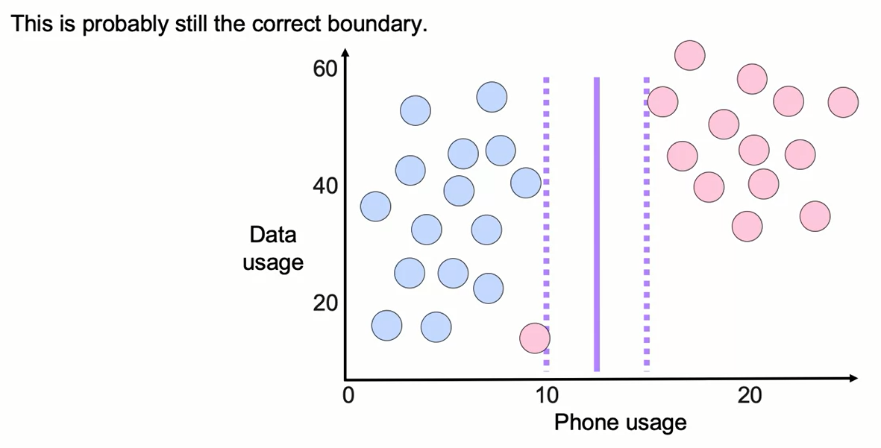
Outlier Sensitivity in SVMs

Slide 35
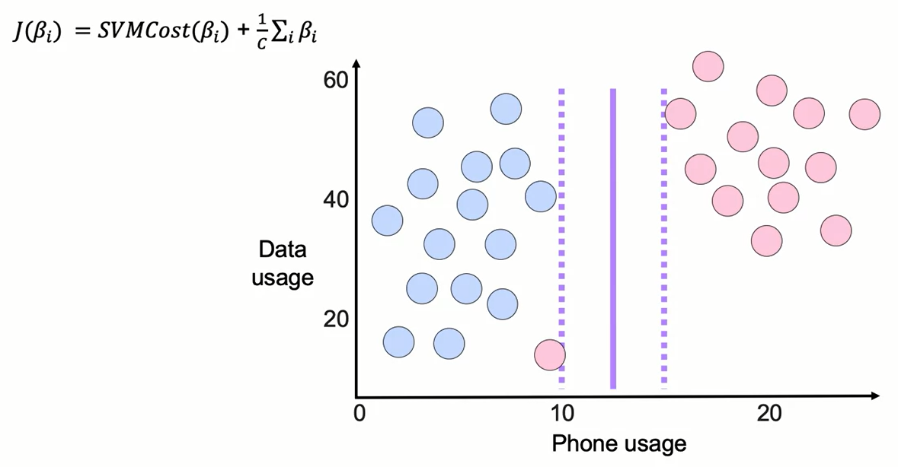
Regularization in SVMs

Slide 36
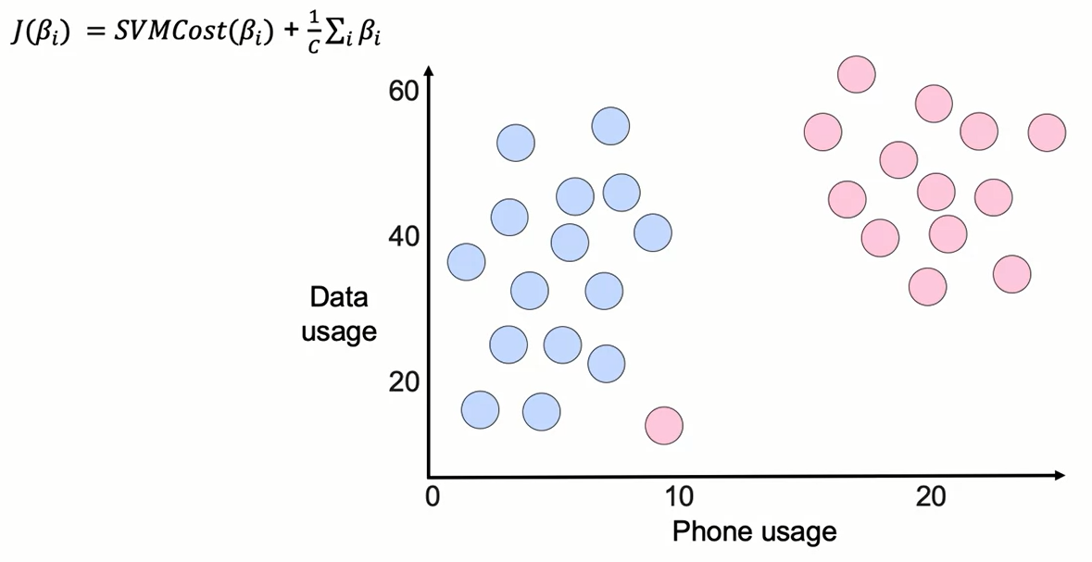
Regularization in SVMs

Slide 37
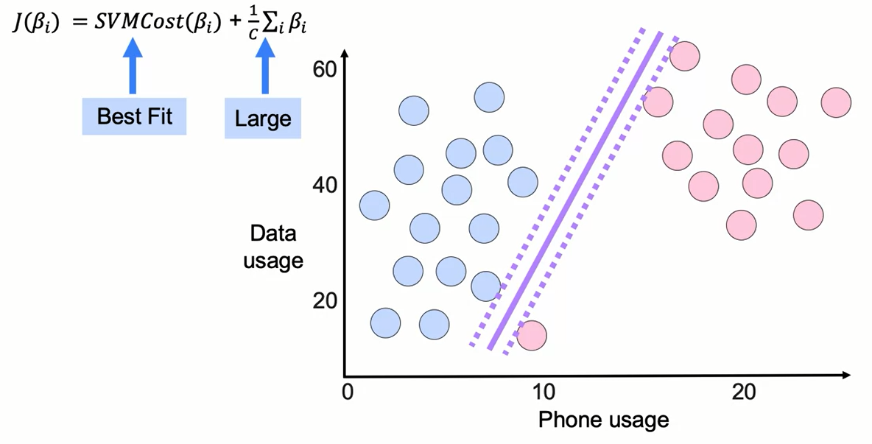
Regularization in SVMs

Slide 38
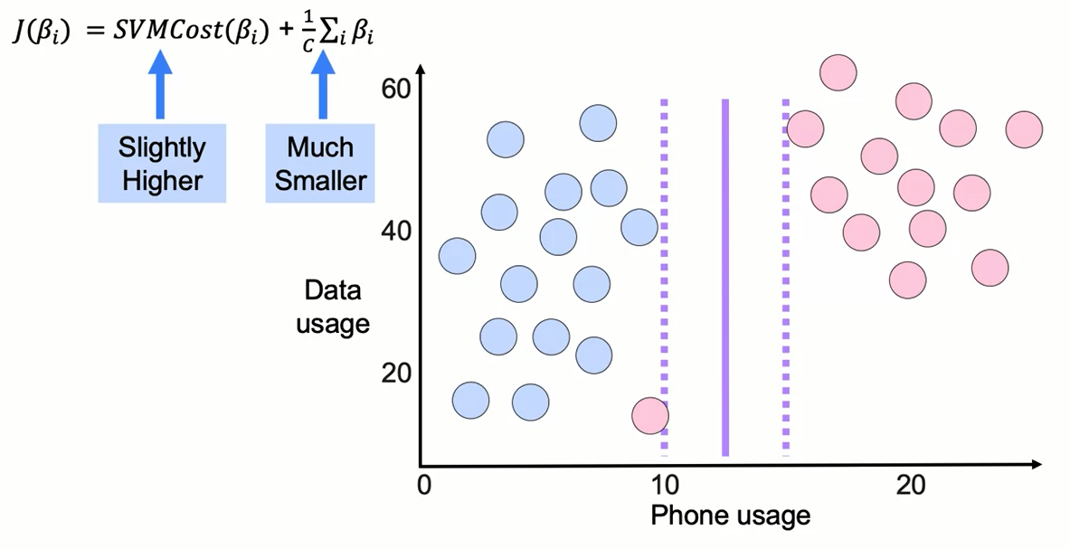
Regularization in SVMs

Slide 39
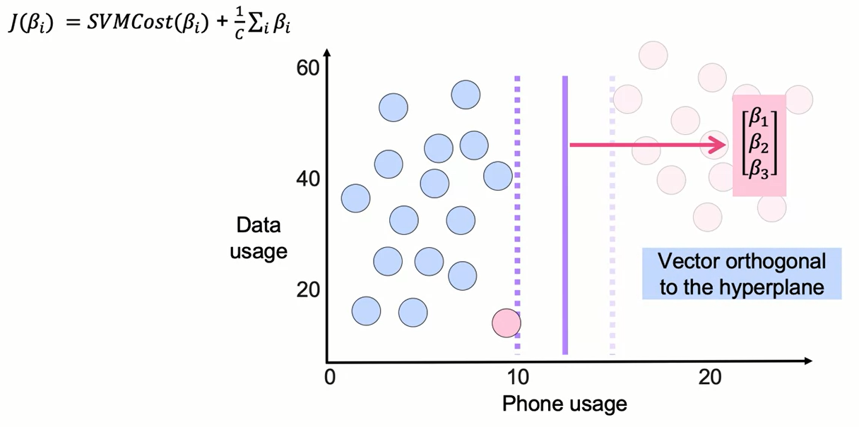
Interpretation of SVM Coefficients

Slide 40
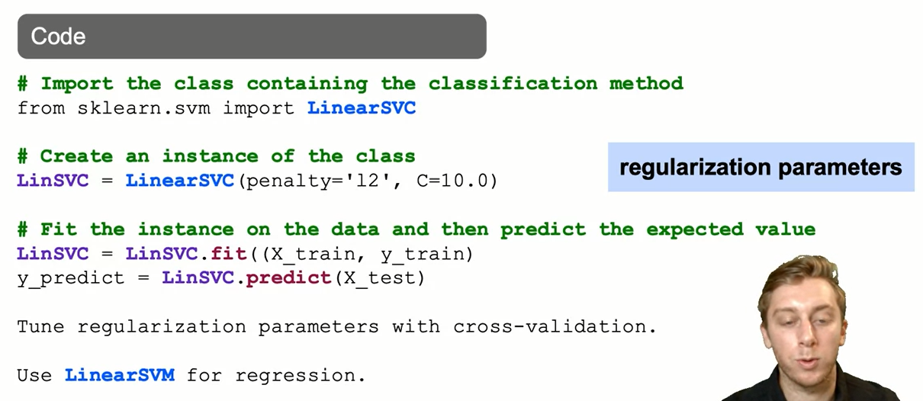
Linear SVM: The Syntax

Slide 41
Summary
The main idea behind Support Vector Machines is to find a hyperplane that separates classes by determining decision boundaries that maximize the distance between classes.
When comparing logistic regression and SVMs, one of the main differences is that the cost function for logistic regression has a cost function that decreases to zero, but rarely reaches zero. SVMs use the Hinge Loss function as a cost function to penalize misclassification. This tends to lead to better accuracy at the cost of having less sensitivity on the predicted probabilities.
Regularization can help SVMs generalize better with future data.

Slide 42
Learning Recap
In this section, we discussed:
- Support Vector Machines (SVM) approach to Classification
- Comparing SVM and Logistic Regression
- The SVM cost function
- Regularization in SVM models

